Slide 1

Presentation Name
Speaker Name

Slide 2







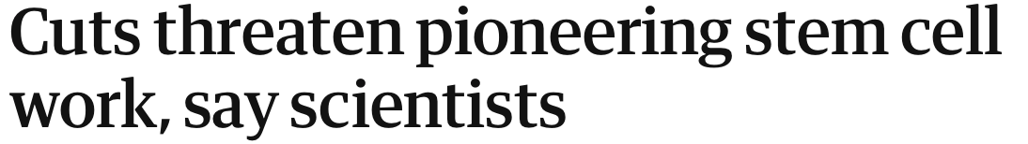
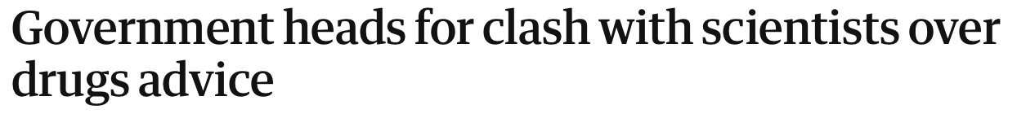
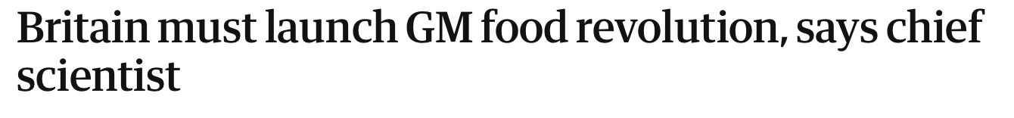

The increasing impact of research

Slide 3
“We can do more working together”
The leading boundary-spanning platform connecting universities with policymakers
Working across local, regional, devolved, national and international governments
Represent two-thirds of Higher Education Institutes in the UK
11
Members
60+ Members
2018
2019
2020
2021
30+ Members
90+ Members

Slide 4


Our Members
Notes:
Updated July 2021

Slide 5
Our Threefold Mission
1
2
3
Broker: To harness the collective research power of UPEN members to increase the impact of research on public policy.
Collaborate: To collaborate with policy professionals to provide coordinated, diverse and efficient access to evidence and expertise.
Learn: To share learning and best practice around knowledge exchange and policy impact between UK universities.

Slide 6












1. Broker
We are a ‘one stop shop’ – a central point for policymakers to connect with researchers

Slide 7




2. Collaborate
Working with stakeholders to improve the mechanisms of academic- policy engagement and shape the agenda

Slide 8











Building a network

Slide 9
3. Learn
We share experiences with members and stakeholders about how to foster world class research that underpins policy
140+ blogs written by our members and key stakeholders
50+ training events, roundtables and member meetings
3000+ twitter follows
10,000+ visits a month to the UPEN website
Notes:
Updated July 2021

Slide 10

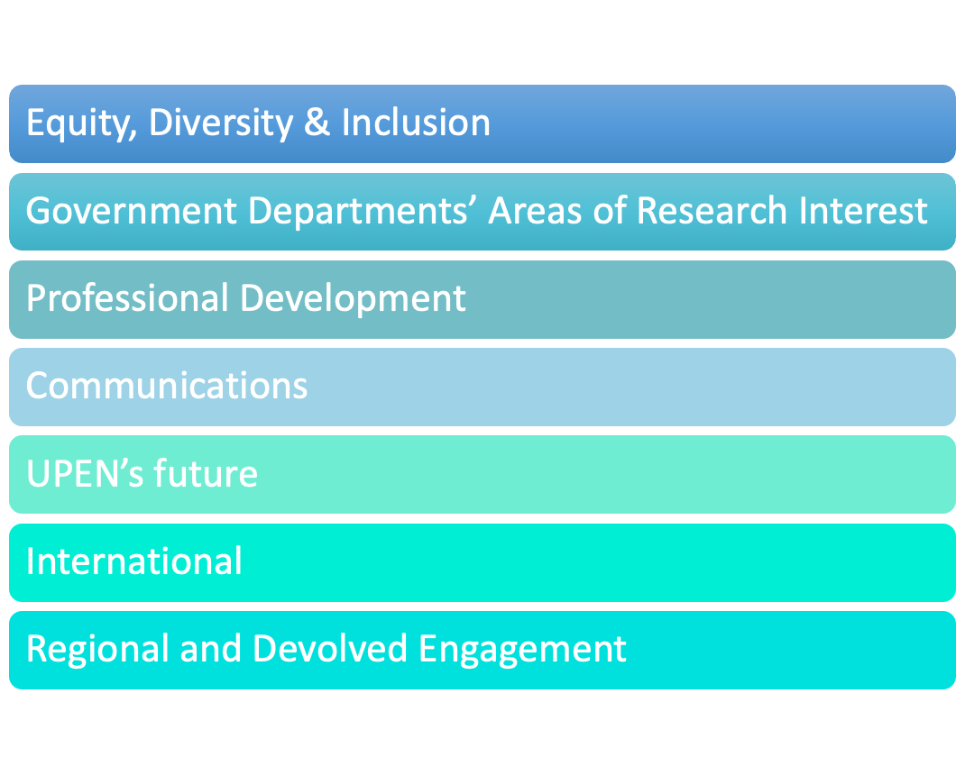
UPEN Subcommittees

Slide 11
Key Areas of Focus 2021-23
Sustainability of the network
Equity, diversity & inclusion
Professional Development
Communications
Government department's Areas of Research Interest

Slide 12




www.upen.ac.uk
@PolicyUPEN
secretariat@upen.ac.uk

